Slide 1
Importance of Monitoring
T. Alex Cabral, M.P.A.
Deputy Regional Administrator
NHTSA Region 5

Slide 2
"...those of us who manage the public's dollars will be held to account, to spend wisely, reform bad habits, and do our business in the light of day, because only then can we restore the vital trust between a people and their government.“- President Obama

Slide 3
Purpose
Discuss forms of sub-grantee fraud, what can we do?
Monitoring
Provide the warning signs on potential fraud
Self-monitoring
Offer strategies to prevent fraud.

Slide 4
It can happen any where
Former Illinois Police Commander Charged with False Statements
On February 20, 2013, a former police commander, Des Plaines, Illinois, Police Department, was charged in U.S. District Court, Chicago, Illinois, with false statements relating to a scheme to defraud a NHTSA funded program.
From approximately 2009 through 2012, it is alleged the Commander made false statements in reports that concealed the police department's failure to meet the requirements of federally funded impaired driving enforcement campaigns. The Commander, the project director for the police department, allegedly inflated DUI arrests that resulted in the department receiving $132,893 in federal reimbursement for overtime compensation by the Commander and other police officers. As the project director, the Commander was responsible for certifying departmental compliance with NHTSA's participation requirements. The Commander inflated the DUI arrests and provided false information about blood alcohol content levels on the reimbursement forms.
Note: An indictment, information, and criminal complaint are only accusations by the Government. All defendants are presumed innocent unless and until proven guilty.

Slide 6
Fraud Risk Factors: Management/Internal Controls-(What do we do?)
Three most common contributing factors:
Lack of communication regarding program management-Grantee Meetings
Lack of training to supervisors, officers and other grantees.-Meetings with staff, share and go over all specifics of the grant.
Lack of supervision in grant procedures-Develop policies and procedures

Slide 7
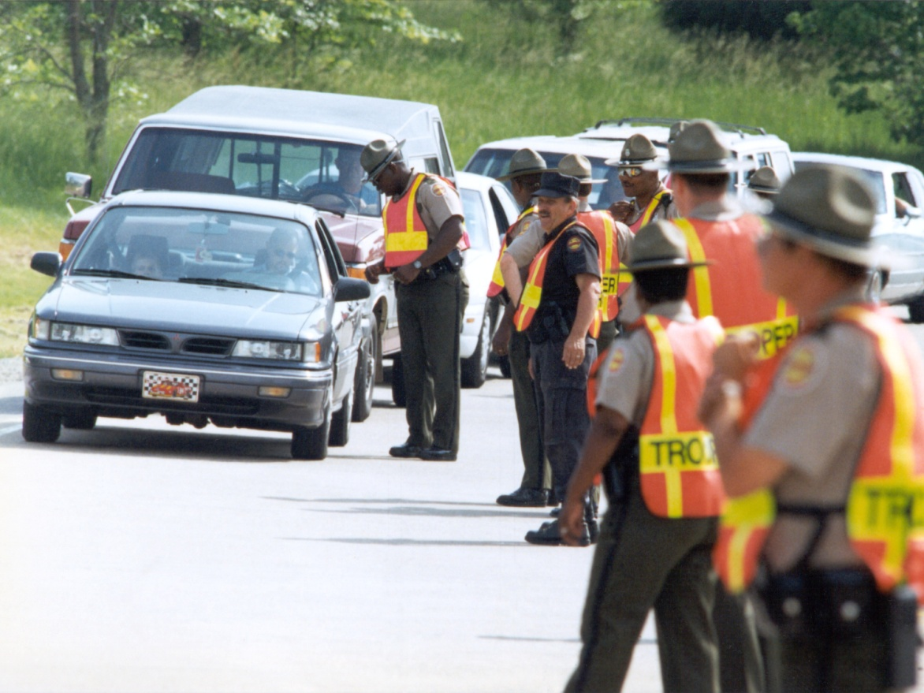
Monitoring

Slide 8
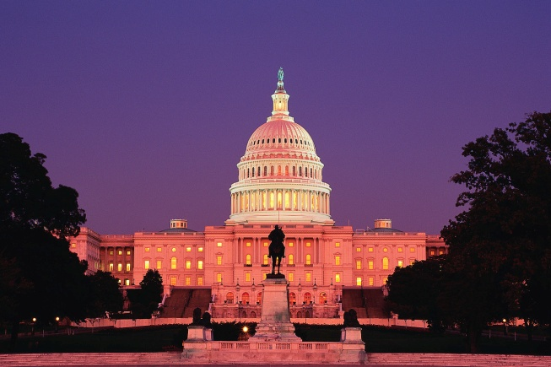
Why do we monitor?
Stewards of the public funds
First line defense
Deter and prevent
Accountability to Congress

Slide 9
Who is monitored?
HVEO Grants
OVI Grants
Safe Community Grants
General Grants
Everyone

Slide 10
Being monitored, self-monitoring (Starts at Home)
Do your own internal monitoring
Spot check yourself
Look over citations/activities
Hours worked, look to the obvious (Excessive hours in one day, hours during normal tour of duty claimed, etc…)

Slide 11
Terms and Conditions-Fine Print
Know what is in your grant

Slide 12
Steps For Conducting Monitoring/ Steps For Being Monitored
Review activities and milestones
Verify that the objectives and project purpose relate
Review dollars spent/unspent
Secure all records not submitted
Inspect equipment/inventory
Discuss the project with the staff

Slide 13
Trouble Signs
Late start
Low activity
Slow expenditure rate
Report discrepancies

Slide 14
Trouble Signs (Cont’d)
Frequent personnel changes
Frequent revisions
Inadequate records
Evasive answers/low morale/poor attitudes

Slide 15
Trouble Signs (Cont’d)
Payment for activities not specified in grant
Salaries claimed did not reconcile with documentation
No/incorrect documentation for mileage reimbursement (cost/mi to operate sub grantee vehicles)
Lack of signature authority/no counter signature
Look at the weather here in the Midwest (Is there activity during a snow or rain storm?)

Slide 16
TX DOT New Procedures

Slide 17
What to do-who to call
SHSO Director
State Attorney General/Auditor/OIG
Local District Attorney
Federal grantor agency (NHTSA)
USDOT-Office of the Inspector General
(800) 424-9071
hotline@oig.dot.gov

Slide 18
Summary
Fraud can occur anywhere
Trust by verification
Better communication, policies and procedures, training and closer supervision can deter fraudulent behavior and malfeasance.
Good monitoring (PRO-ACTIVE)
Starts within (PRO-ACTIVE)

Slide 19
Questions?

